Slide 1
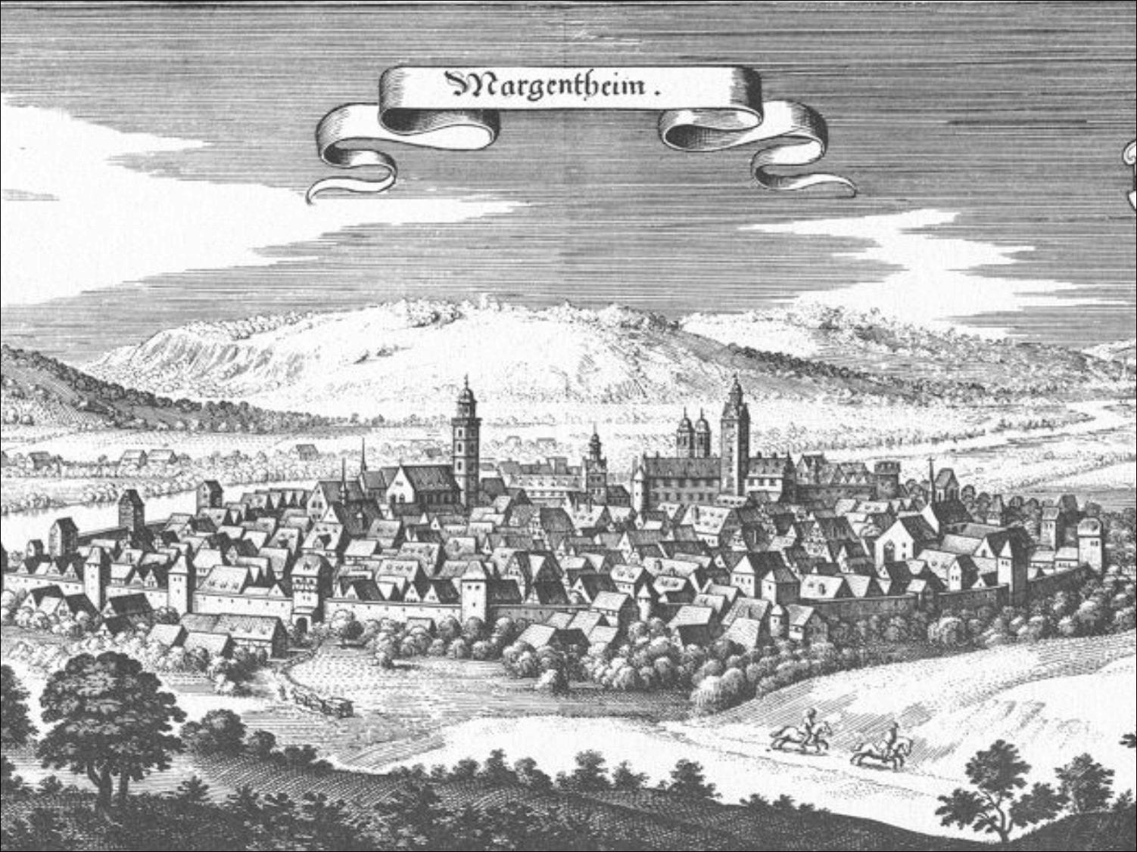
Introduction to International
Business Administration

Slide 2
Globalization
Notes:
This is a test

Slide 3
Prof. Dr. Amit Shah
ashah@frostburg.edu
Notes:
This is a test

Slide 4

American Mobility
How Mobile are Americans?
50 percent of Americans live within 75 km of where they were born.
37 percent have never lived outside their hometown.
57 percent have never left their home state.
The median American lives 29 km from his or her mother (ranges from 7 to 53 km by area).
Only 20 percent live >2 hours from their parents.
Distance is positively related to education.
Notes:
This is a test

Slide 5
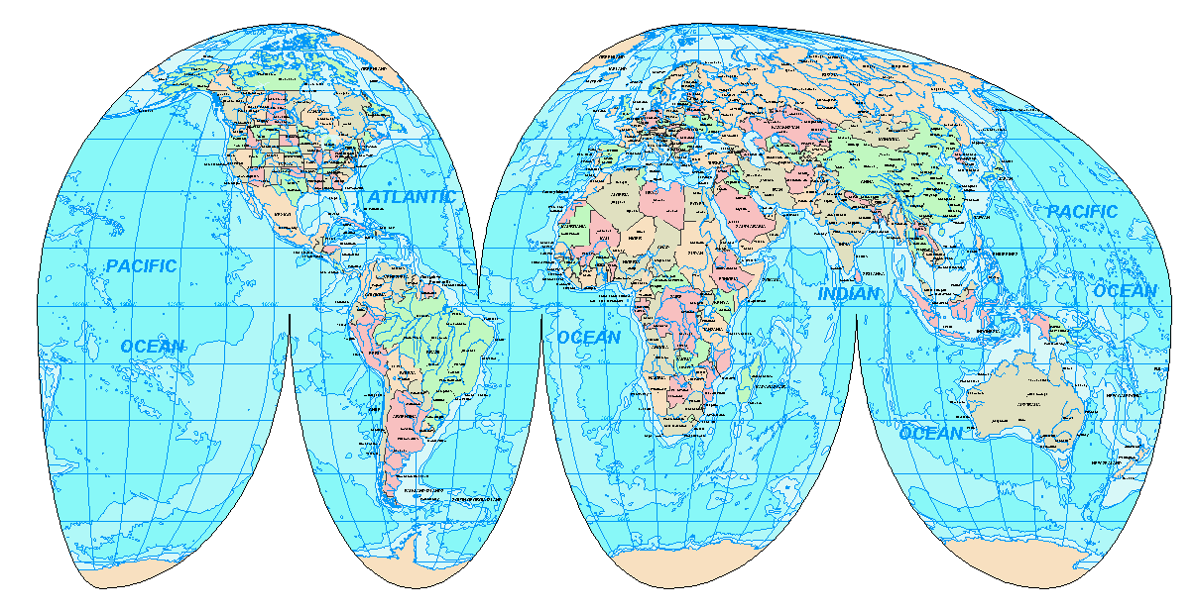
International Business Means ‘the World’

Slide 6
World Interconnections: World Trade
http://wits.worldbank.org/visualization/detailed-product-analysis-visualization.html

Slide 7
World Interconnections: Germany and USA
http://wits.worldbank.org/visualization/country-analysis-visualization.html

Slide 8
Introduction
World Economy Today
  Fewer self-contained national economies.
  More integrated global economic system with lower barriers to trade and investment. → biggest driver
  Transformation is called globalization.
  Today, benefits of globalization are more in dispute than at any time in the last half century.
      This shift has created many challenges and some opportunities, too.
      Globalization continues to impact almost everything we do.

Slide 9
Globalization
What does “globalization” mean?
  What are its causes?
  Why is it proceeding rapidly?
  What is its impact on
    Jobs?
    Incomes?
    Labor and environmental policies?
    National sovereignty?
International Trade patterns
  Foreign direct investment (FDI) flows
  Economic growth rates
  Multinational corporations (MNC) and their impact

Slide 10
Globalization
A shift toward a more integrated and interdependent world economy and away from national economies isolation because of:
  Cross-border trade and investment
  Shrinking of geographic and time (zones) distance
  Rationalizing of national government regulations
  Blending of national cultures

Slide 11
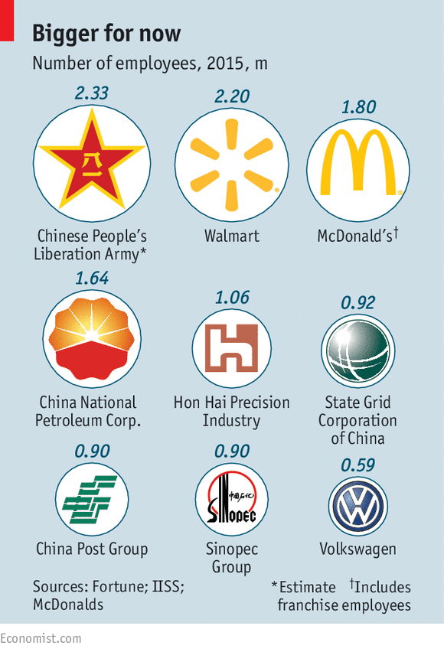
Biggest Enterprises - 2015

Slide 12
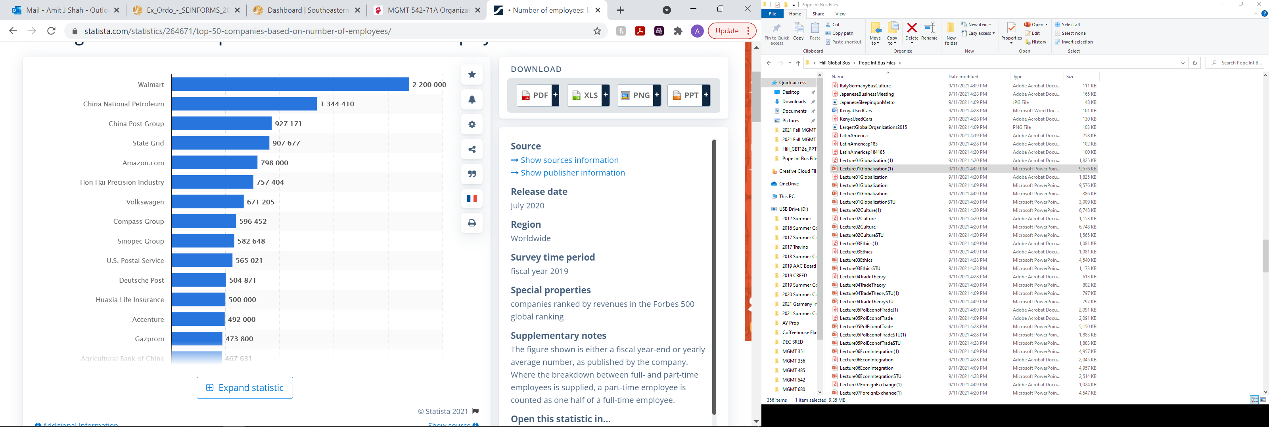
Biggest Enterprises by Employees - 2019
Statista.com

Slide 13
Biggest Enterprises in the World -- 2022
Rank | Employer | Employees | Year | Country
01. | United States Department of Defense | 2.9 million | 2022 | United States
02. | People's Liberation Army | 2.3 million | 2015 | China
03. | Amazon.com, Inc. | 2.2 million | 2021 | United States
04. | China Railway | 2 million | 2013 | China
05. | Ministry of Defence of Russia | 1.9 million | 2017 | Russia
06. | Ministry of Public Security | 1.9 million | 2016 | China
07. | McDonald's Corps | 1.9 million | 2015 | United States
08. | Indian Armed Forces | 1.8 million | 2021 | India
09. | UK National Health Service | 1.7 million | 2015 | United Kingdom
10. | China National Petroleum Corporation | 1.6 million | 2015 | China
11. | Walmart, Inc. | 1.7 million | 2021 | United States
12. | State Grid Corporation of China | 1.5 million | 2015 | China
Wikipedia.org

Slide 14
Globalization
Two main areas of Globalization:
  Markets and Marketing
  Operations and Production

Slide 15
Definitions
MNC: multinational corporation or company
MNE: multinational enterprise
  Same Thing

Slide 16
Globalization of Markets
  The merging of historically distinct and separate national markets into one huge global marketplace.
  In many markets, tastes and preferences of consumers in different nations are converging on some global norm, creating a global market.
      Examples: Coca-Cola, McDonald’s, I K E A, Starbucks, Apple.
The most global of markets are for industrial goods and materials that serve universal needs around the world.
      Aluminum, oil, wheat, microprocessors.

Slide 17
Globalization of Production
Each MNC
  Buys particular goods and services from a set of locations it selects around the world
  Develops a global web of suppliers, i.e. a global supply chain, as a source of competitive advantage
  Decides “where to produce” depending on a country’s factors of production
    Labor, land, capital, management

Slide 18
Emergence of Global Institutions
These define the “rules” of international economic activity
World Trade Organization (W T O)
  Polices world trading system and ensures nation-states adhere to the rules established in W T O treaties.
  Succeeded the General Agreement on Tariffs and Trade (G A T T).
  164 member nations accounted for 98 percent of world trade (2020).
  International Monetary Fund (I M F)
    Maintains order in the international monetary system.
    Lender of last resort.
    Requires nation-states to adopt specific economic policies in return for loans.
World Bank
    Promotes development using low-interest loans.
    Seen as less controversial than I M F.
United Nations (U N)
    Committed to maintaining international peace and security on basis of U N Charter
    Includes 193 member countries.

Slide 19
“Drivers” of Globalization
Two Macro Factors Toward Greater Globalization
  Decline in barriers to free flow of goods, services, and capital.
  Technological change.

Slide 20
Drivers of Globalization
Declining Trade and Investment Barriers
  International trade occurs when a firm exports goods or services to consumers in another country.
  Foreign direct investment (F D I) occurs when a firm invests resources in business activities outside its home country.
  During 19 20s and 19 30s, many nations put up barriers to international trade to protect domestic industries.
  After W W I I, advanced Western countries reduced barriers.
    G A T T, Uruguay Round, and W T O.
Notes:
Foreign direct investment: invest in one country; f.e. tesla opens up a factory in berlin
International trade: import sth from another country; tesla imports cars from usa to Germany

Slide 21
Average Tariff Rates on Manufactured Products as Percentage of Value
Country | 19 13 | 19 50 | 19 90 | 2018
France | 21 percent | 18 percent | 5.9 percent | 3.9 percent
Germany | 20 | 26 | 5.9 | 3.9
Italy | 18 | 25 | 5.9 | 3.9
Japan | 30 | -- | 5.3 | 2.5
Netherlands | 5 | 11 | 5.9 | 3.9
Sweden | 20 | 9 | 5.9 | 3.9
United Kingdom | -- | 23 | 5.9 | 3.9
United States | 44 | 14 | 5.7 | 3.1
Notes:
Table summarizes the impact of GATT agreements on average tariff rates for manufactured goods among several developed nations. As can be seen, average tariff rates have fallen significantly since 1950 and by 2018 stood at about 3.0 to 4.0 percent.
High tariffs → discourage international trade → home grown goods are far cheaper (less added cost cause of tariffs)

Slide 22
Evidence of Globalization -- Trade
World trade increased more than
  20 times between 1950 and 1998
  25 times from 1970 to 2002
  In 2019, the global trade value of goods exported throughout the world amounted to approximately 19 trillion U.S. dollars compared to around 6.45 trillion U.S. dollars in 2000.

Slide 23
Evidence of Globalization -- FDI
FDI annual flows increased more than
  10 times from 1984 to 1998, or
  50 times between 1975 and 2000
  Last three years it has been on the decline
  For US: In the last 20 years, the amount of FDI in the United States has more than doubled. In 2000, FDI was 1.26 trillion U.S. dollars and in 2020 it had risen to 4.63 trillion U.S. dollars.
  Top 3 countries for FDI in 2017: The Netherlands, USA, and U.K.
Notes:
FDI = foreign direct investment
Last few years decreased → cause of covid

Slide 24
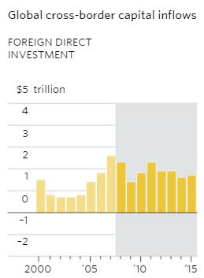
FDI Flows since 2000

Slide 25
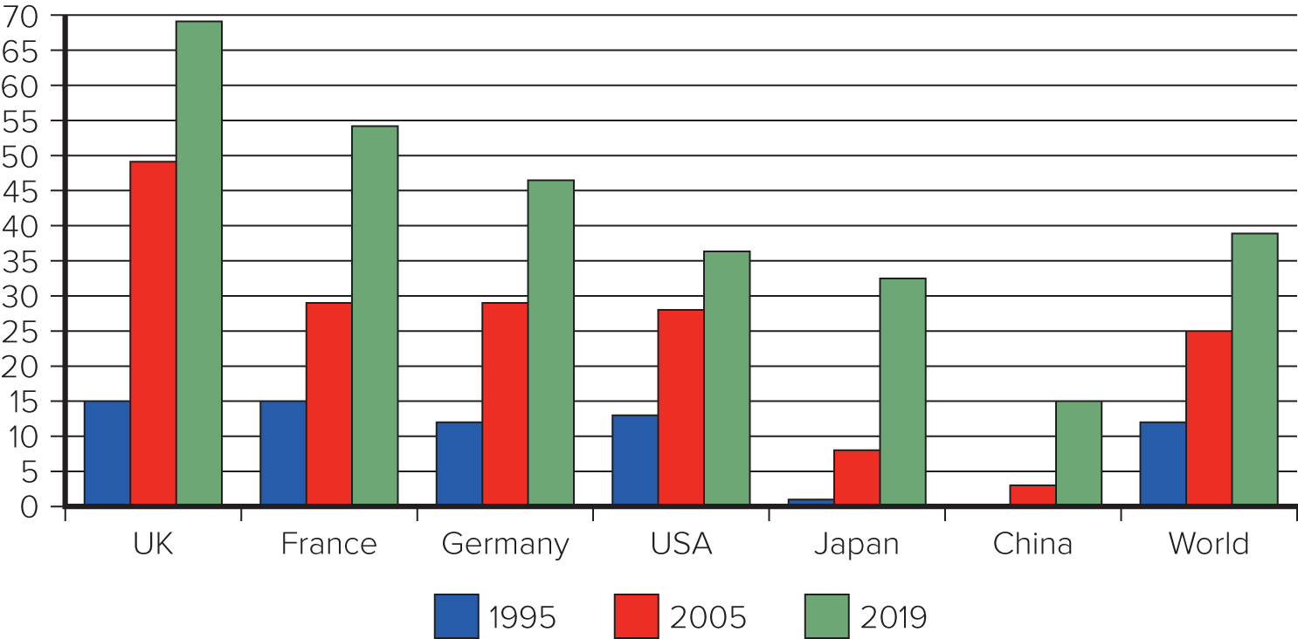
FDI as a % of GDP

Slide 26
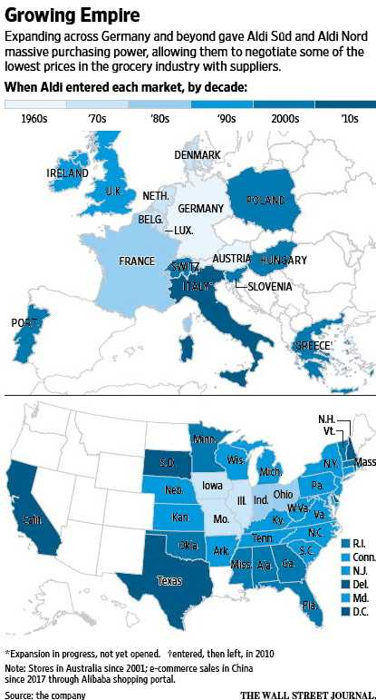
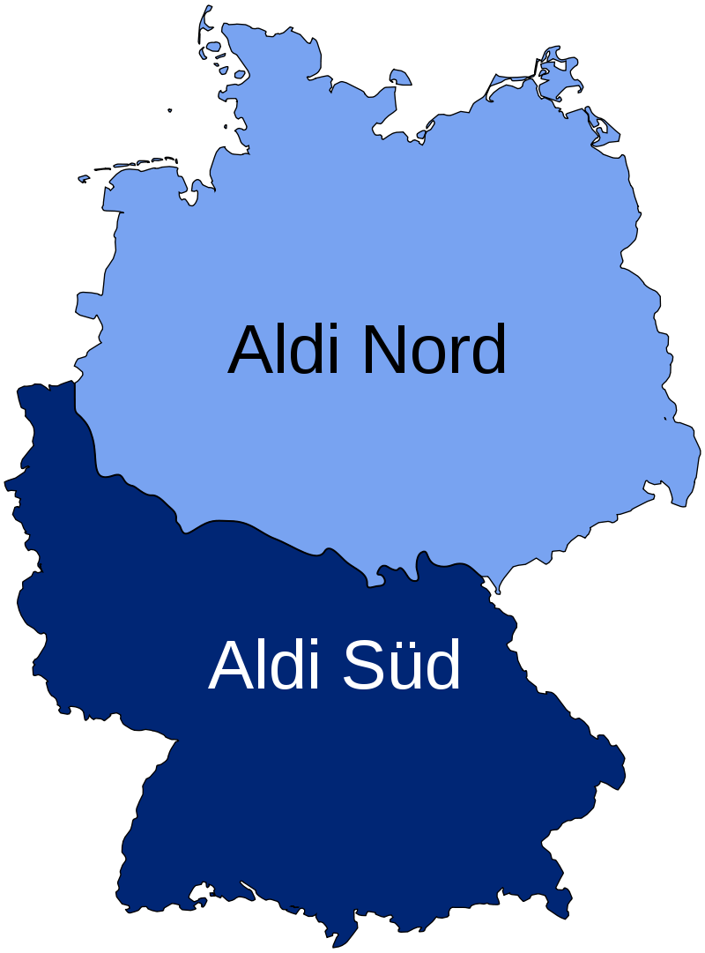
FDI--Aldi
More than 11,000 stores, 20 countries
Sales = €50 billion
Investing $4 billion more in
USA by 2022.
USA includes Aldi Süd and
Trader Joe’s.
WSJ, 22 Sep 2017, p. A1. and Company Website
Notes:
Aldi > Lidl

Slide 27

FDI--Daimler
Alabama to Receive $1 Billion Investment
Daimler AG said Thursday it will invest US$1 billion in its Alabama manufacturing operations
WSJ, 22 Sep 2017, p. B4.
Notes:
Getting close to the customer is important
To get around tariffs

Slide 28
Drivers of Globalization
Declining Trade and Investment Barriers (continued)
  Some firms finding home markets under attack from foreign competitors.
  Global financial crisis of 2008 to 2009 and drop in global output that occurred led to more calls for trade barriers to protect jobs at home.
      Resulting trade wars, such as one between U.S. and China.
      May slow the rate of globalization and production.
    COVID-19 global pandemic has had a significant impact on global supply chains, and thus on globalization.
Notes:
The World Trade Organization has forecasted that due to the ongoing COVID-19 pandemic, world trade will slump by as much as one third in 2020, while cross border investment may fall by 40%.

Slide 29
“Drivers” of Globalization: Technological Change
  Communications:
    Since World War I I, microprocessor created explosive growth of high-power, lost-cost computing.
    Microprocessors also advanced telecommunications.
      Moore’s Law: as costs of microprocessors fall, their power increases.
Notes:
Moore’s law: The power of microprocessor technology doubles and its costs of production fall in half every 18 months.
→ Every 18 month capacity doubles and cost is reduced by half

Slide 30
Role of Technological Change:
    The Internet:
    In 2019, 4.5 billion users (58 percent of global population).
    Reduces constraints of location, scale, and time zones.
  Transportation Technology:
    Commercial jets, super freighters.
    Innovation of containerization has significantly lowered shipping costs.
Notes:
Containerization has revolutionized the transportation business, significantly lowering the costs of shipping goods over long distances. Because the international shipping industry is responsible for carrying about 90 percent of the volume of world trade in goods, this has been an extremely important development.
Containerization: transport of containers across multiple kinds of vehicles
Reduces labour cost
Reduces time lost : don’t need to unpack and repack stuff
Bringing a lot of stuff across the world → use containers

Slide 31
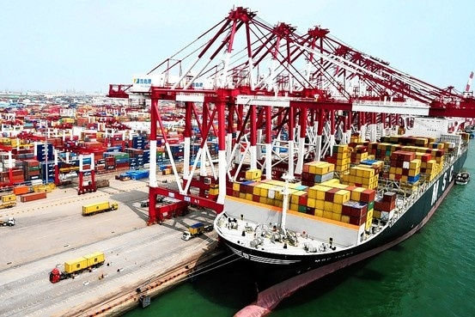
Containerization

Slide 32
Role of Technological Change (continued)
  Implications for the Globalization of Production:
    Lower transportation costs makes geographically dispersed production system more economical; allows firms to better respond to demand shifts.
  Implications for the Globalization of Markets:
    Low-cost communication networks create electronic global marketplace.
    Low-cost transportation makes shipping products around the world economical.
    Reduced cultural distance.
    Converging consumer tastes and preferences.
Notes:
Allows to companies to resource from everywhere around the world

Slide 33
The Changing Demographics of the Global Economy
Global Economy: Early 19 60s
  U.S. dominated the world economy, world trade.
  U.S. dominated world F D I.
  U.S. M N Es dominated international business.
  About half the world was off limits to Western international business.
  Today, much has changed.
Notes:
FDI → US used to be the one leading everything

Slide 34
The Changing Demographics of the Global Economy
Today:
U.S. accounts for only 24 percent.
Germany, France, the U.K., and Canada had similar decline.
Rapid economic growth now in countries like China, India, Russia, and Brazil.
Chinese economy could surpass U.S. within a decade.
Further relative decline by the U.S. and others is likely.
Notes:
Overall, the World Bank has estimated that today’s developing nations may account for more than 60 percent of world economic activity by 2030, while today’s rich nations, which currently account for more than 55 percent of world economic activity, may account for only about 38 percent.
Developing countries are expected to control most of the output

Slide 35
Changing Demographics of World Output and World Exports
Country | Share of World Output in 1960 (%) | Share of World Output Today (%) | Share of World Exports Today (%)
United States | 38.3 percent | 24.0 percent | 8.2 percent
Germany | 8.7 | 4.6 | 7.1
France | 4.6 | 3.2 | 2.8
Italy | 3.0 | 2.4 | 2.4
United Kingdom | 5.3 | 3.3 | 2.3
Canada | 3.0 | 2.0 | 2.2
Japan | 3.3 | 6.0 | 3.6
China | N A | 15.2 | 11.1
Notes:
As can be seen from Table, from 1960 to today, China’s share of world output increased from a trivial amount to 15.2 percent, making it the world’s second-largest economy in terms of its share in world output (the U.S. is still the largest economy overall). Other countries that markedly increased their share of world output included Japan, T4hailand, Malaysia, Taiwan, Brazil, and South Korea.
Single most reason to produce in china → lower labour costs

Slide 36
The Changing Demographics of the Global Economy
The Changing Foreign Direct Investment Picture
  World output generated by developing countries has been steadily increasing since 19 60s.
  Stock of foreign direct investment (total cumulative value of foreign investments) generated by rich industrial countries is declining.
  Cross-border flows of foreign direct investment is rising.
  Largest developing country recipients of F D I are China, Mexico, and Brazil. (= receive the most money)
Notes:
Reflecting the dominance of the United States in the global economy, U.S. firms accounted for 66.3 percent of worldwide foreign direct investment flows in the 1960s. British firms were second, accounting for 10.5 percent, while Japanese firms were a distant eighth, with only 2 percent. The dominance of U.S. firms was so great that books were written about the economic threat posed to Europe by U.S. corporations. Several European governments, most notably France, talked of limiting inward investment by U.S. firms.
To be developed county: also looks at political, cultural aspects, not only economic factors

Slide 37
The Changing Demographics of the Global Economy
The Changing Nature of the Multinational Enterprise
  A multinational enterprise (M N E) is any business that has productive activities in two or more countries.
  In last 50 years, rise of non-U.S. multinationals and growth of mini-multinationals.
  Non-U.S. Multinationals.
    Large number of U.S. multinationals reflects U.S. economic dominance.
    Today, world economy is shifting away from North America and western Europe.
Notes:
Mininationals: small to medium sized companies; that are still internationally active

Slide 38
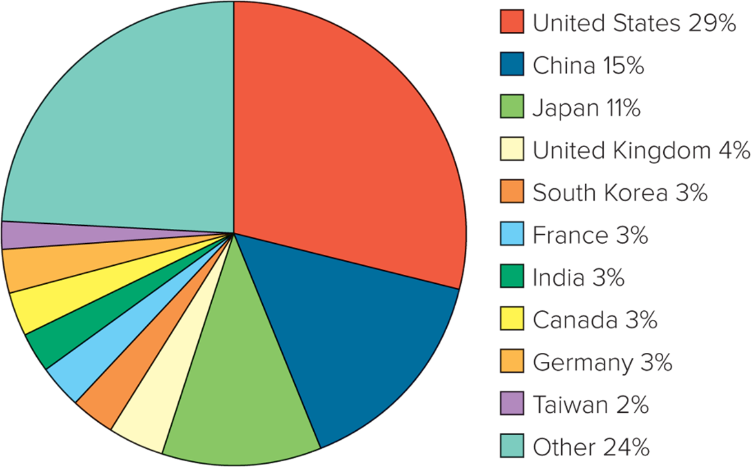
National Share of the Largest 2,000 Multinational Corporations in 2019
Notes:
As shown in Figure, by 2019 the U.S. share had fallen to 28.8 percent, or 575 firms, and the Japanese share had declined to 11.1 percent, while Chinese enterprises had emerged to comprise 309 of the total, or 15.5 percent. There has also been a notable increase in multinationals from Taiwan, India, and South Korea.

Slide 39
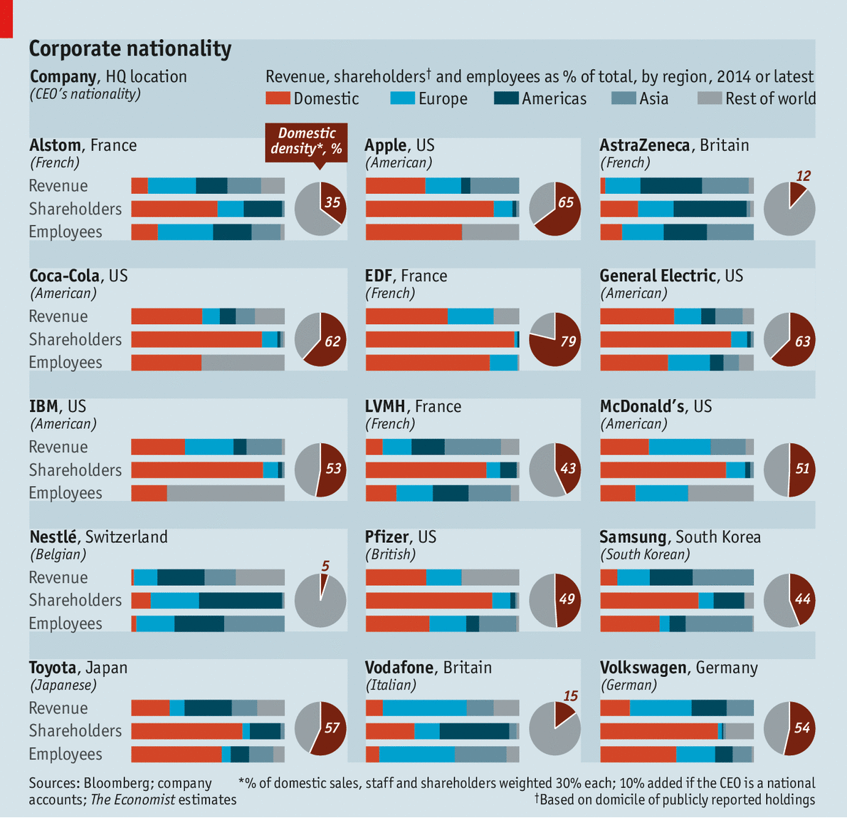
National Origin of MNEs: what nationality am I?

Slide 40
The Changing Demographics of the Global Economy
The Changing World Order
    Collapse of communism throughout eastern Europe.
    Economic development in China.
    Free market reforms and democracy in Latin America.

Slide 41
The Globalization Debate
Is A More Integrated and Interdependent Global Economy Good?
  Experts believe globalization promotes greater prosperity in the global economy, more jobs, and lower prices for goods and services.
  Others feel that globalization is not beneficial.

Slide 42
Globalization: Good or Bad for Workers?
In the U.S.:
  Workers in businesses that import and/or export earn 15-20 percent more than in businesses that do not.
  Workers in multi-national companies earn 25-30 percent more than in companies that are just domestic.
  The benefits of globalization are 20 percent greater for blue collar than white collar workers.
  Slaughter, Matthew J., “The Free-Trade Way to Job Growth, WSJ, 2 October 2014, p. A15.

Slide 43
Globalization: Who took my job?
Early 1990s
Small town near Charlotte, NC, USA
Aluminum smelter closed after 50 years
Only significant industry in town
In many families, several generations had worked there. Now all out of work.
Who caused it to close?
Notes:
In age of globalization:
Do not know who your competition is
Or what changes will affect you

Slide 44
Mobile Phones
What company dominated the mobile phone market in the 1980s?
What new company in the business became dominant in the 1990s?
What new company in the business became dominant in 2007?
Neither of these new dominant companies had even been in the mobile phone business before they became dominant!

Slide 45
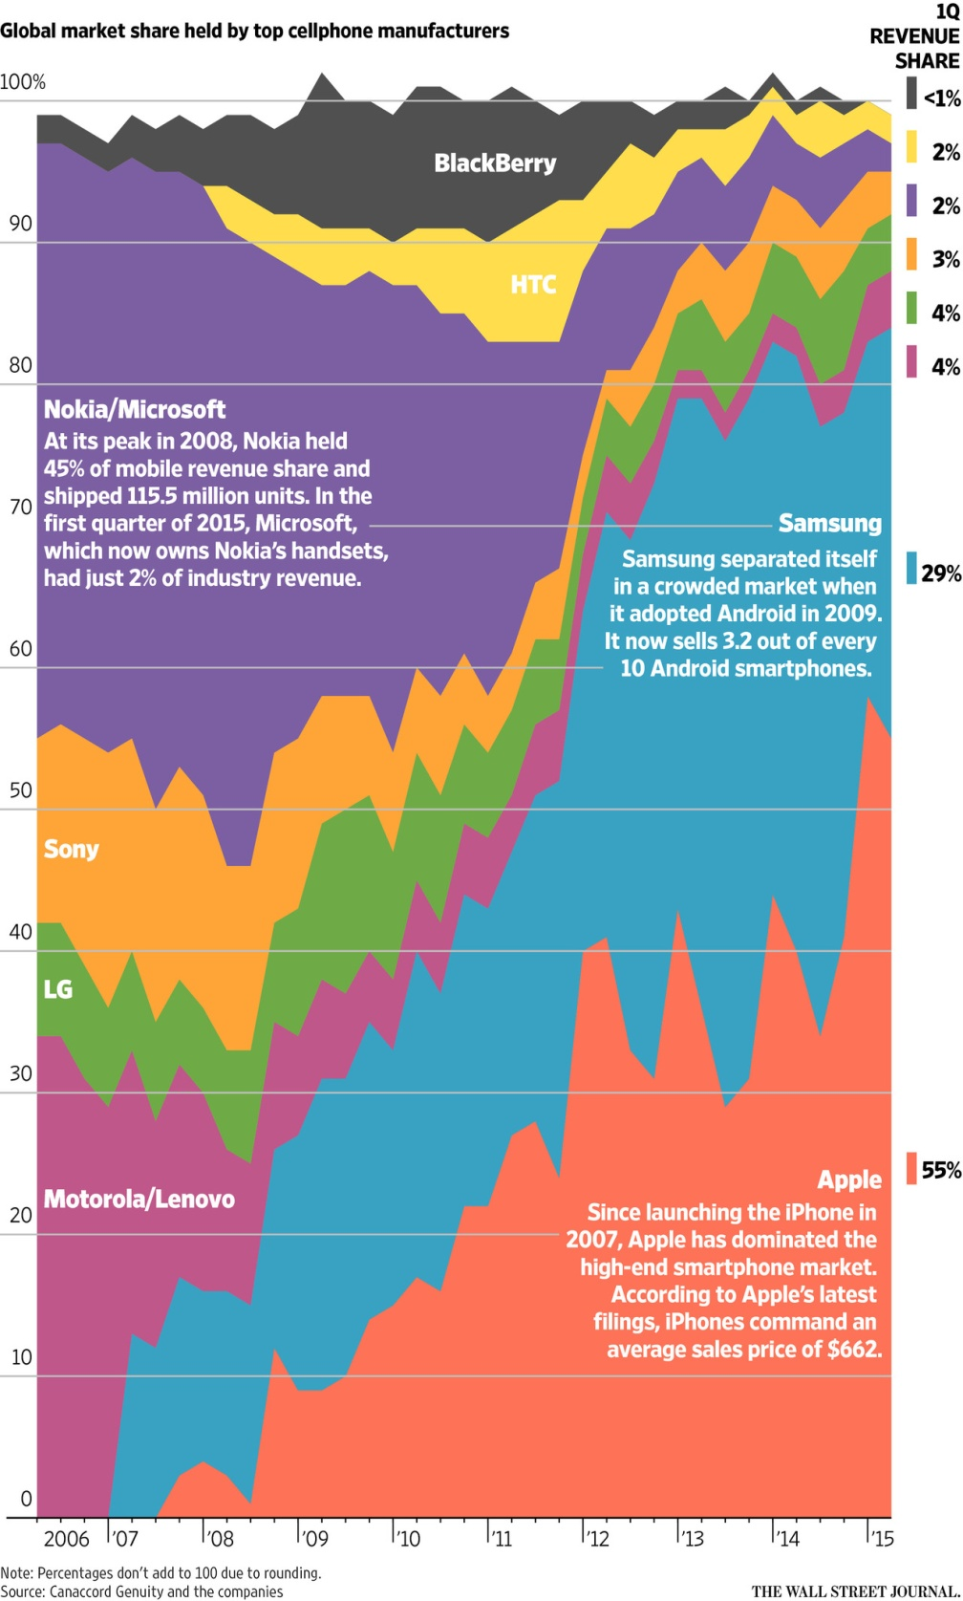
Mobile
Phone Market

Slide 46
Currents Threats to Globalization
Politics / Protests
Recession
Unemployment
Demographics
The rise/fall of China
Government finances
Stagnant growth
Geo-political factors

Slide 47


Slide 48
End of Globalization Lecture

